Slide 1
IBM Watson Build Challenge Summary

Slide 2
IBM Watson Build Challenge
https://www.ibm.com/partnerworld/wps/static/watsonbuild/
Team: New York Power Authority, Starboard, and RPI (J. Chow, M. Wang, L. Vanfretti, Q. Ji)
Selected in Phase 1; now in Phase 2 competition (due Oct. 2017)
Proposal: develop cognitive solutions to power system control room operation, including alarming processing and control augmentation, by linking cognitive processing of warning messages and technical analysis of various sources of power system data
The cognitive processing part will rely on Watson APIs
Power system data analysis will be based on technical tools developed by the RPI team

Slide 3





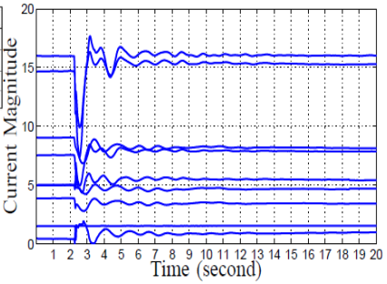
Cognitive Solutions to Power System Control Room Operation
Warning Messages
Watson Retrieve and Rank
API
RPI Data Analysis Al Algorithms
Control Room
Messages of tolerance limits exceeded
Rank the exceeded limits events
Missing Data Recovery
Static Overload Estimation
Disturbance Recognition
Streaming Data
Our Application
Supports operator decision with multi-source power system data
NoSQL
Data Base

Slide 5
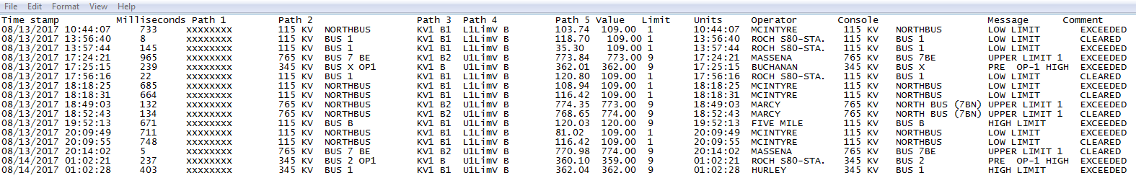
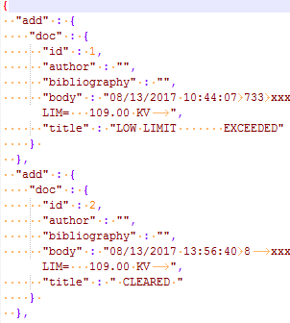

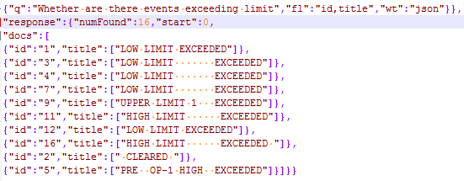
Alarming Processing based on Watson Text Processing
Raw warning messages
Document Conversion
Training
of Retrieve and Rank
Testing
of Retrieve and Rank
Question:
Response:

Slide 6
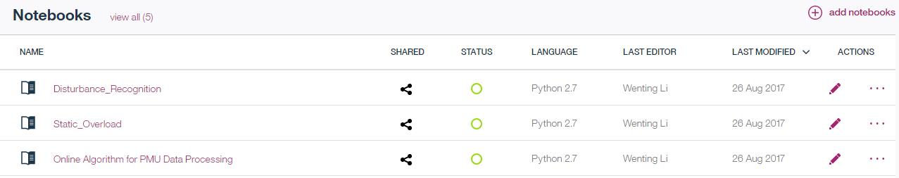

Control Augmentation
Three Data Analysis algorithms are implemented on IBM Data Science Experience
Online Missing Data Recovery
Static Overload Estimation
Disturbance Recognition

Slide 7
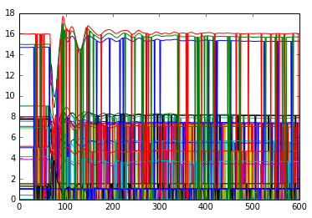
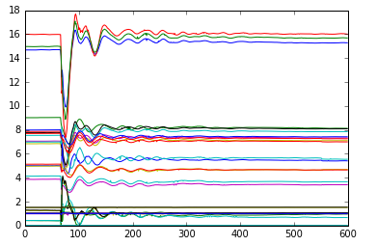
Online Missing Data Recovery
Functions:
To recover the missing data of phase measurement units (PMU) streaming data
Input:
PMU streaming datasets;
(a)
Output:
The reconstructed PMU streaming datasets.
Fig. 1 (b) is the reconstructed results.
(b)
Fig. 1: Voltage magnitudes and current magnitudes before (a) and after (b) data recovery

Slide 8
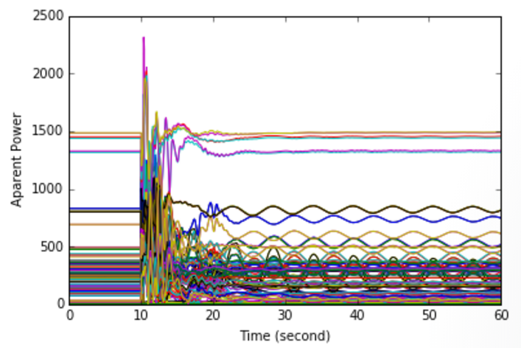
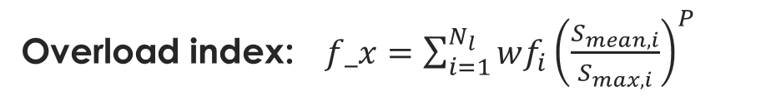
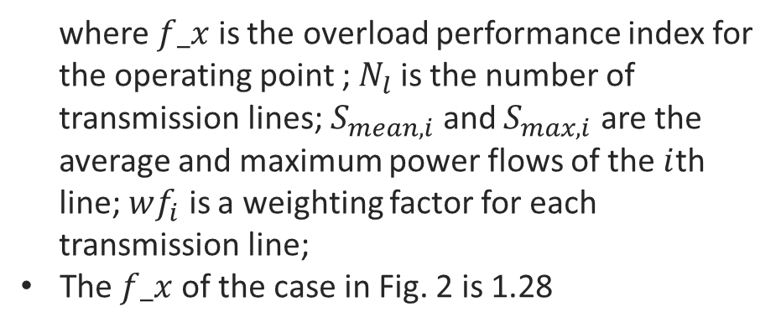
Static Overloading Estimation
Functions:
To check whether the operational limits of the transmission lines have been breached.
To check whether steady state is reached.
Input:
Power flow data
Output:
Overload index
Overload index:$f_x=\sum_{i=1}^{N_{l}}{wf_{i}{\left(\frac{S_{mean,i}}{S_{max,i}}\right)}^{P}}$
where $f_x$ is the overload performance index for the operating point ; $N_{l}$ is the number of transmission lines; $S_{mean,i}$ and $S_{max,i}$ are the average and maximum power flows of the $i$th line; $wf_{i}$ is a weighting factor for each transmission line;
The $f_x$ of the case in Fig. 2 is 1.28
Fig. 2: Apparent power after a disturbance

Slide 9
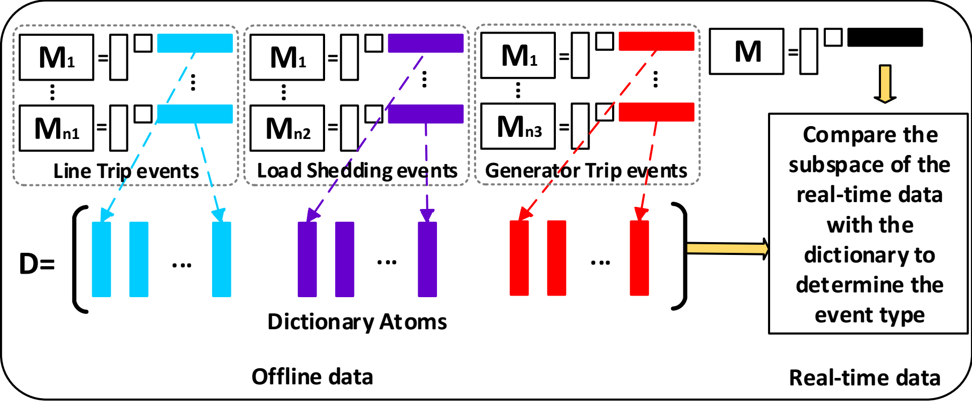
Disturbance Recognition
Functions:
To identify the type of the events by comparing the subspace of online data with the constructed dictionary
Fig. 3 shows the main idea of our disturbance recognition method
Input:
Post-event PMU datasets in one second
Output:
The type of the event
Fig. 3: Dictionary construction from historical datasets and real-time data identification through subspace comparison

